Slide 1
Computer Architecture CSEN 3104 Lecture 3
Dr. Debranjan Sarkar

Slide 2
Various types of Instruction Set Architecture
Accumulator architecture
General Register based architecture
Register-Memory architecture
Memory-Memory architecture
Register (Load/ store) architecture
Stack architecture

Slide 3
Accumulator architecture
A single register, called the Accumulator is used to
process all the instructions
store the operand before the operation
store intermediate results
store the result after the operation
Instruction format has only one operand (in register or memory)
Accumulator almost always implicitly used
This type of CPU is known as one-address machine
Example: MULT X [ X = address of the operand]
(AC) ← (AC) * mem[X]

Slide 4
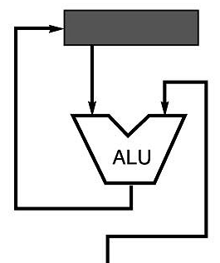
Accumulator architecture
Example: A*B - (X+Y*Z)
load Z
mul Y
add X
store C
load A
mul B
sub C
Advantages
Very low hardware requirements
Easy to design and understand
Short instruction and less memory space
Instruction cycle is faster
Disadvantages
Accumulator becomes the bottleneck
Little ability for parallelism or pipelining
Program size increases as many short instructions are required
High memory traffic and more execution time
Accumulator
Memory

Slide 5
General Register Architecture
Multiple general purpose registers (GPRs)
Two or Three address fields in the Instruction Format
Each address field may specify a general register or a memory word
One operand Register and other operand Memory → Register-Memory architecture
All operands memory → Memory-Memory architecture
Example (3-address)
SUB R1, A, B which means (R1) ← mem[A] – mem[B]
MULT R1, R2, R3 which means (R1) ← (R2) * (R3)
Example (2-address)
MULT R1, R2 which means (R1) ← (R1) * (R2)
ADD R1, A which means (R1) ← (R1) + mem[A]

Slide 6
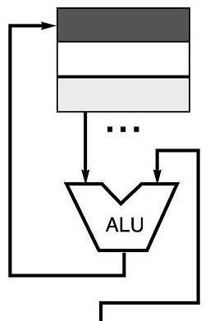
General Register Architecture
Registers
Example: A*B - (X+Y*Z)
3 operands 2 operands
mul D, A, B mov D, A
mul E, Y, Z mul D, B
add E, X, E mov E, Y
sub E, D, E mul E, Z
add E, X
sub E, D
Advantages
Many registers are used, so program size is less
Requires fewer instructions (especially if 3 operands)
Less memory required to store the program
Easy to write compilers for (especially if 3 operands)
Disadvantages
Very high memory traffic (especially if 3 operands)
Variable number of clocks per instruction
With two operands, more data movements are required
Memory

Slide 7
Register (Load/ Store) Architecture
Divides instructions into two categories:
Memory access (Load and Store between memory and registers)
Arithmetic / Logic operations (which only occur between registers)
For example, both operands and destination for an ADD operation must be in registers
Only load and store instructions access the memory (memory indirect addressing mode)
All other instructions use registers as operands.
Primary motivation is speedup –registers are faster
RISC instruction set architectures such as PowerPC, SPARC, RISC-V, ARM and MIPS are load–store architectures

Slide 8
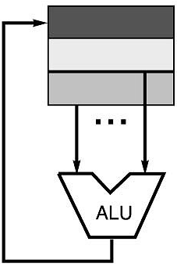
Load/ Store Architecture
Registers
Example: C = A*B - (X+Y*Z)
load R1, &A
load R2, &B
load R3, &X
load R4, &Y
load R5, &Z
mul R7, R4, R5 /* Y*Z */
add R8, R7, R3 /* X + Y*Z */
mul R9, R1, R2 /* A*B */
sub R10, R9, R8 /* A*B – (X+Y*Z) */
store R10, &C
Advantages
Simple, fixed length instruction encodings
Instructions take similar number of cycles
Relatively easy to pipeline and make superscalar
Disadvantages
Higher instruction count
Not all instructions need three operands
Dependent on good compiler

Slide 9
Stack architecture
What is stack?
A portion of memory, used to store operands in successive locations
A data structure in which a list of data is accessed with LIFO access method
Only two operations: PUSH and POP
PUSH inserts one operand at the top of the stack
POP takes out one operand from the top of the stack
Operands are pushed or popped from one end only
Stack Pointer (SP) holds the address of the top of the stack

Slide 10
Example of PUSH and POP
PUSH <memory address>
SP ← SP – 1
Top of stack ← < memory address>
POP <memory address>
< memory address> ← Top of stack
SP ← SP + 1

Slide 11
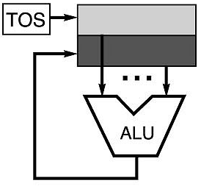
Stack architecture
No operand
This type of CPU is known as zero-address machine
The two operands are on the top of the stack
Result will be on the top of stack
Example: A*B - (X+Y*Z)
push A
push B
mul
push X
push Y
push Z
mul
add
sub
Stack

Slide 12
Stack architecture
Advantages
No address field -> length of the instruction is short
Low hardware requirements
Efficient computation of complex arithmetic expression
Execution of instruction is fast, because operands are stored in consecutive memory locations
Easy to write a simpler compiler for stack architectures
Disadvantages
Stack becomes the bottleneck
Little ability for parallelism or pipelining
Difficult to write an optimizing compiler for stack architectures

Slide 13
Ordering of bytes within a multi-byte word
Big Endian
Least significant byte has highest address
Store the most significant byte first (at the lower address)
More natural
The sign of the number can be determined by looking at the byte at address offset 0.
Strings and integers are stored in the same order.
Example: Sun, Mac
Little Endian
Least significant byte has lowest address
Store the most significant byte last (at the highest address)
Makes it easier to place values on non-word boundaries.
Conversion from a 16-bit integer address to a 32-bit integer address does not require any arithmetic.
Example: Alphas, PCs

Slide 14
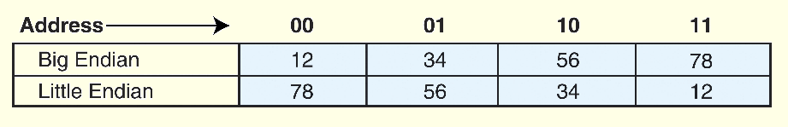
Example of Byte Ordering
As an example, suppose we have the hexadecimal number 12345678.
The big endian and small endian arrangements of the bytes are shown below.

Slide 15
Arithmetic Expression Evaluation
Infix notation
Example: (A + B) * (C + D)
Polish Notation (or Prefix notation)
Example: +AB (in Prefix) means A + B (in Infix)
No parenthesis required
Reverse Polish Notation (or Postfix notation)
Example: AB+ (in Postfix) means A + B (in Infix)
No parenthesis required
Stack oriented computers are better suited to postfix notation than Infix notation
Example: (A +B) * [C/(D-E) + F] is equivalent to AB+CDE-/F+*
Explain with a Numerical example

Slide 16
Thank you

